Slide 1

Information about Covid-19
Information actualized about Covid-19 in Catalonia
Mario Gonzalez Gonzalez
Nacho Munné Anacleto
2 DAW

Slide 2
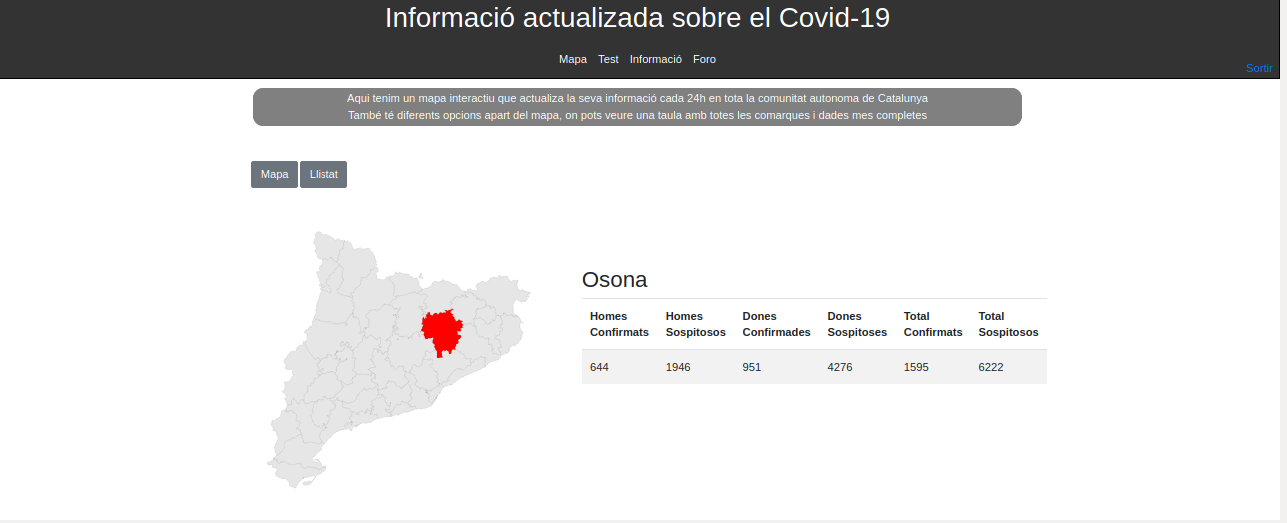

Slide 3
Our program implements an API of the generality that allows us to take the information on all the counties of Catalonia, our work, is to implement this API to make a better operation of the same. We have also created a similar test that asks questions to save this information about possible new cases in a table that we manage. We also have a page full of information that the user can visit. And finally we have a forum where all our users can communicate.

Slide 4

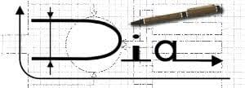





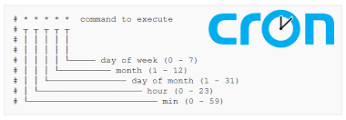



Slide 6
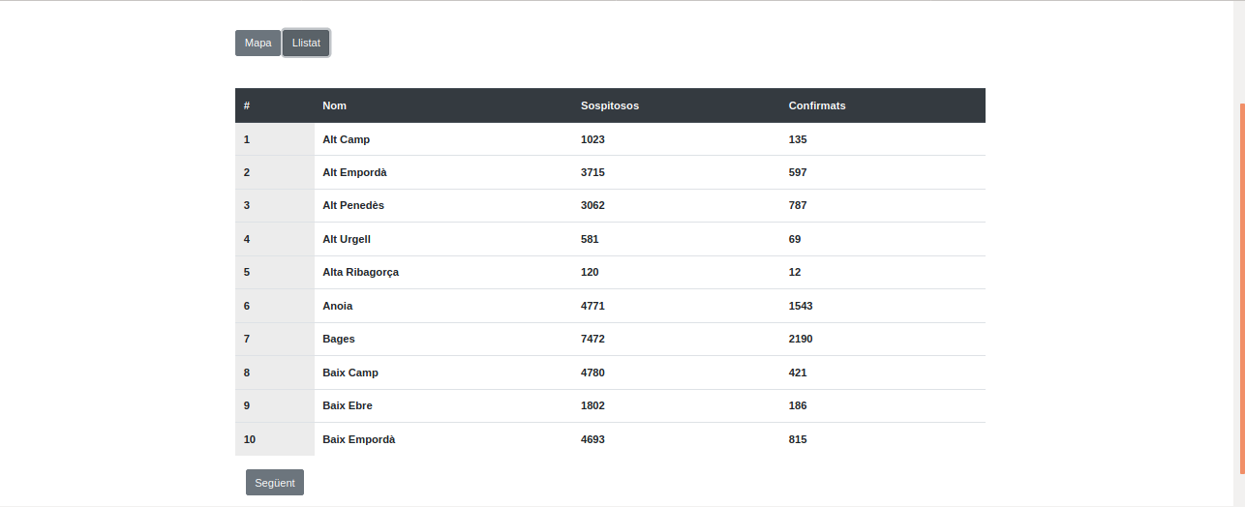

Slide 7
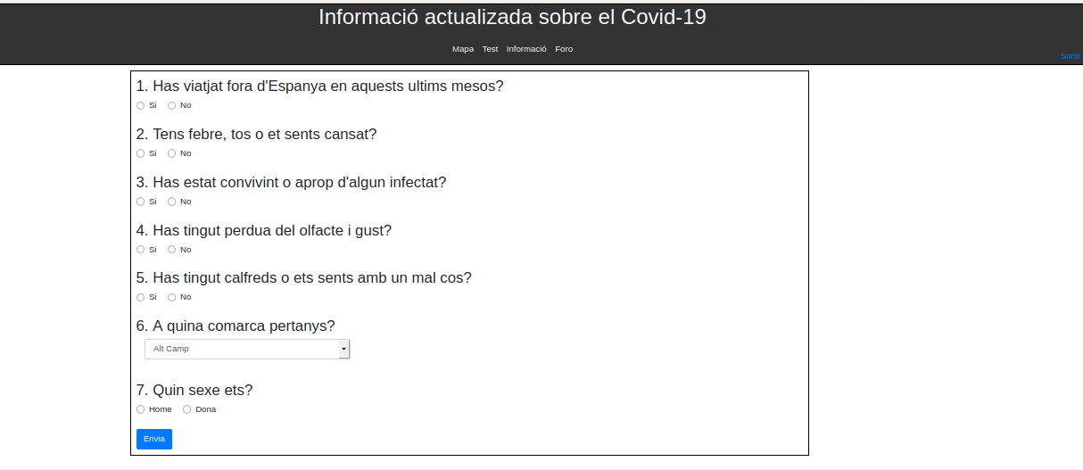

Slide 8
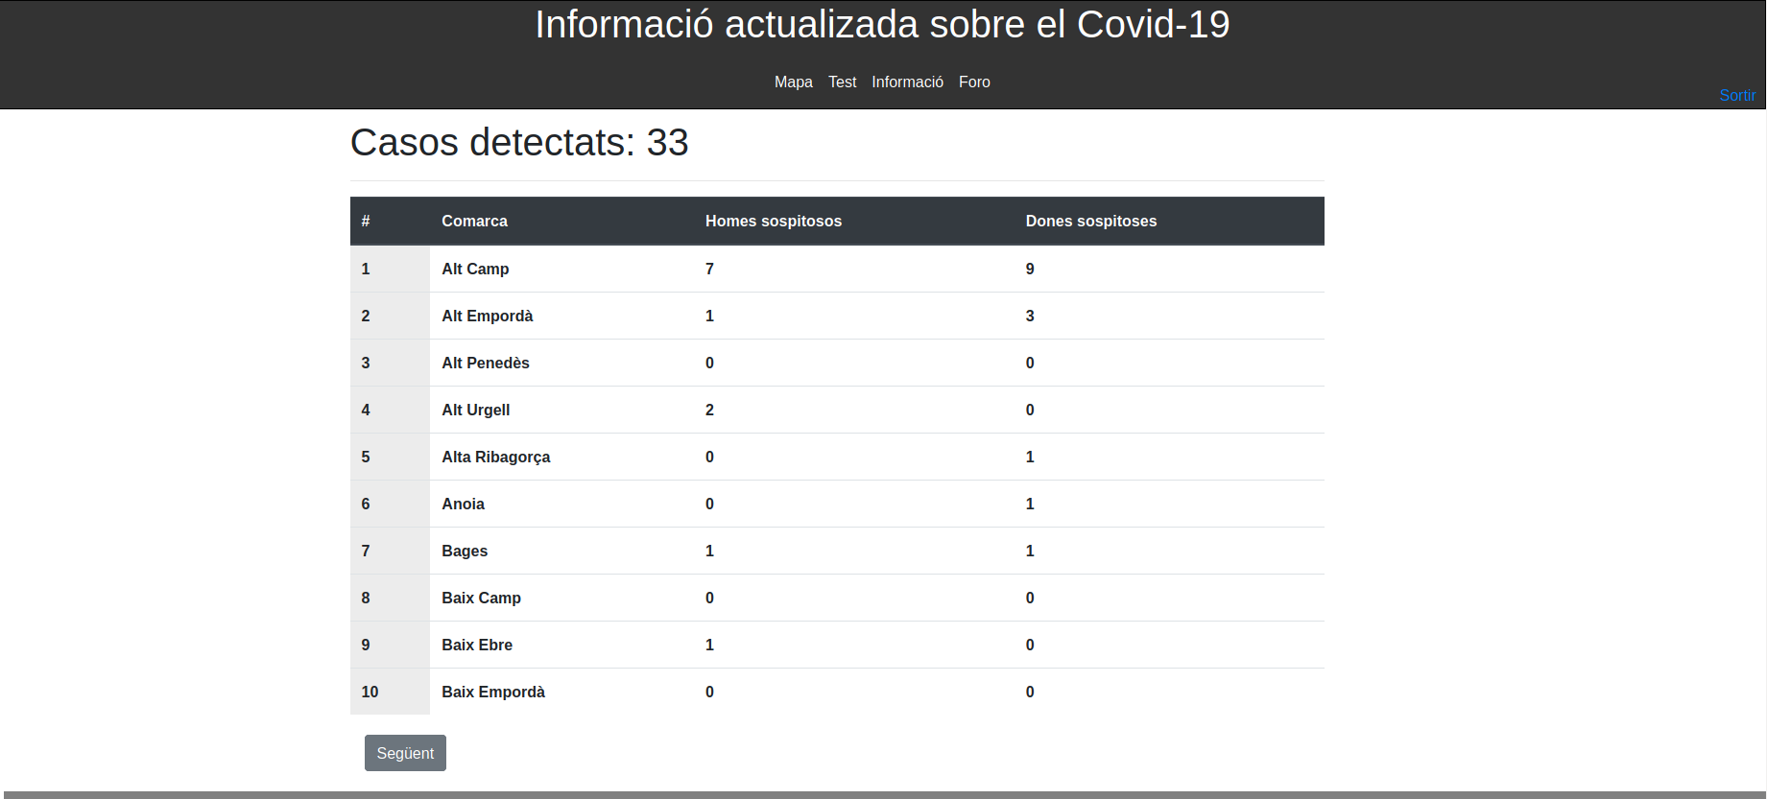

Slide 9
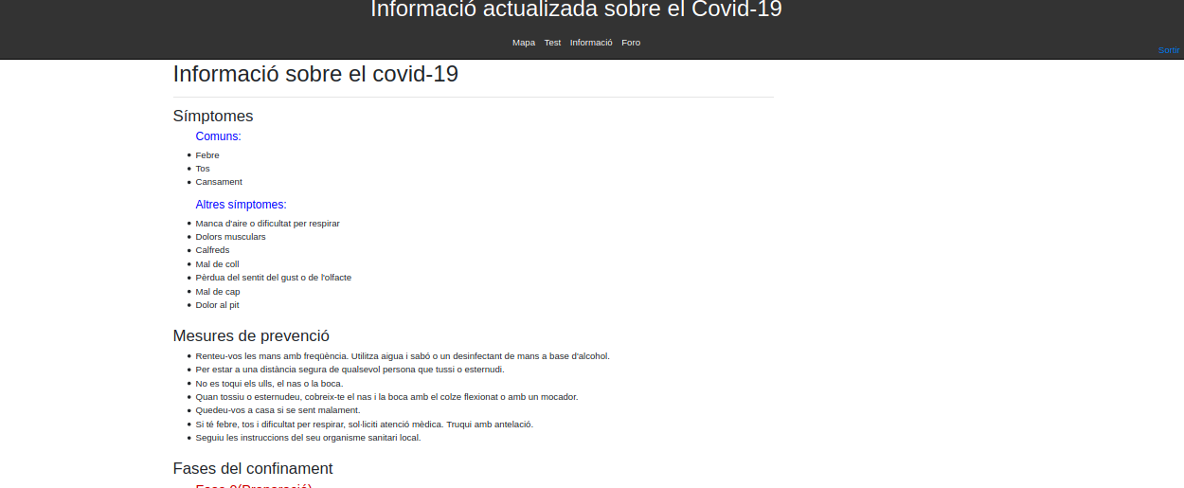

Slide 10
